Slide 1
Python Conditionals
Life Choices Coding Academy 2020

Slide 2
Learning Outcome
By the end of this section, students should be able to:
Know how to use python if else statement.
Get input from the user using the input function.

Slide 3
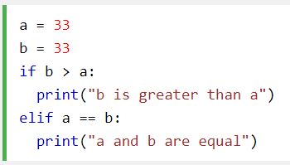


Intro to if statement
What is an if statement used for?
Else clause is optional.
Colon is required.
The <expr> should be either true or false.
Notes:
An if statement is used to check a condition and if the condition is true, we run block of statement(s) (called the if-block), else we process another block of statement(s) (called the else-block)
The elif keyword keyword is pythons way of saying “if the previous conditions were not true, then try this condition”.
Highlight the importance of indentation https://www.quora.com/Why-is-indentation-so-important-in-Python

Slide 4
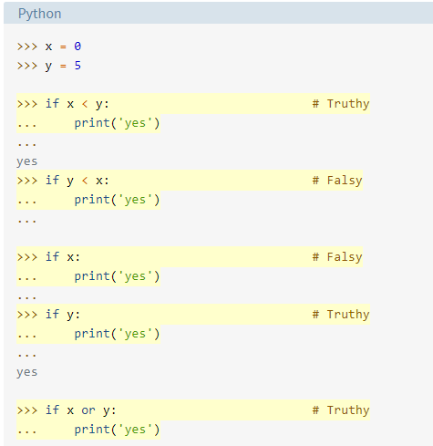
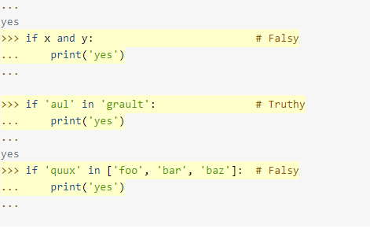
Some Examples...
Notes:
If you are trying these examples interactively in the interpreter, you’ll find that, when you hit Enter after typing in the print('yes') statement, nothing happens. Because this is a multiline statement, you need to hit Enter a second time to tell the interpreter that you’re finished with it. This extra newline is not necessary in code executed from a script file.

Slide 5
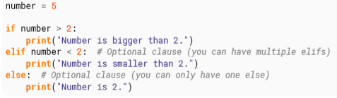
If, elif, and else
What do you think is the output of the following program and why?
Notes:
Output: Number is bigger than 2

Slide 6
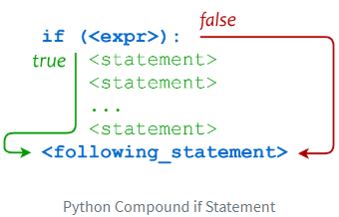
Grouping Statements: Indentation and blocks
Python follows a convention known as the off-side rule.
Expressed by their indentation.
Other languages uses free-form.
Expressed by their curly-brackets.
Notes:
https://en.wikipedia.org/wiki/Off-side_rule
Add code here to show the difference between. JS and Python/ maybe java or c++.
Maybe a hello world program for each language.

Slide 7
Thanks :)

Slide 8
Exercise time :)

